Slide 1
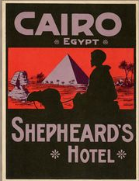
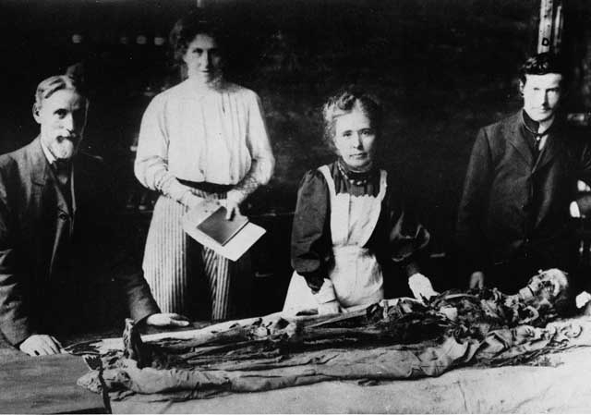
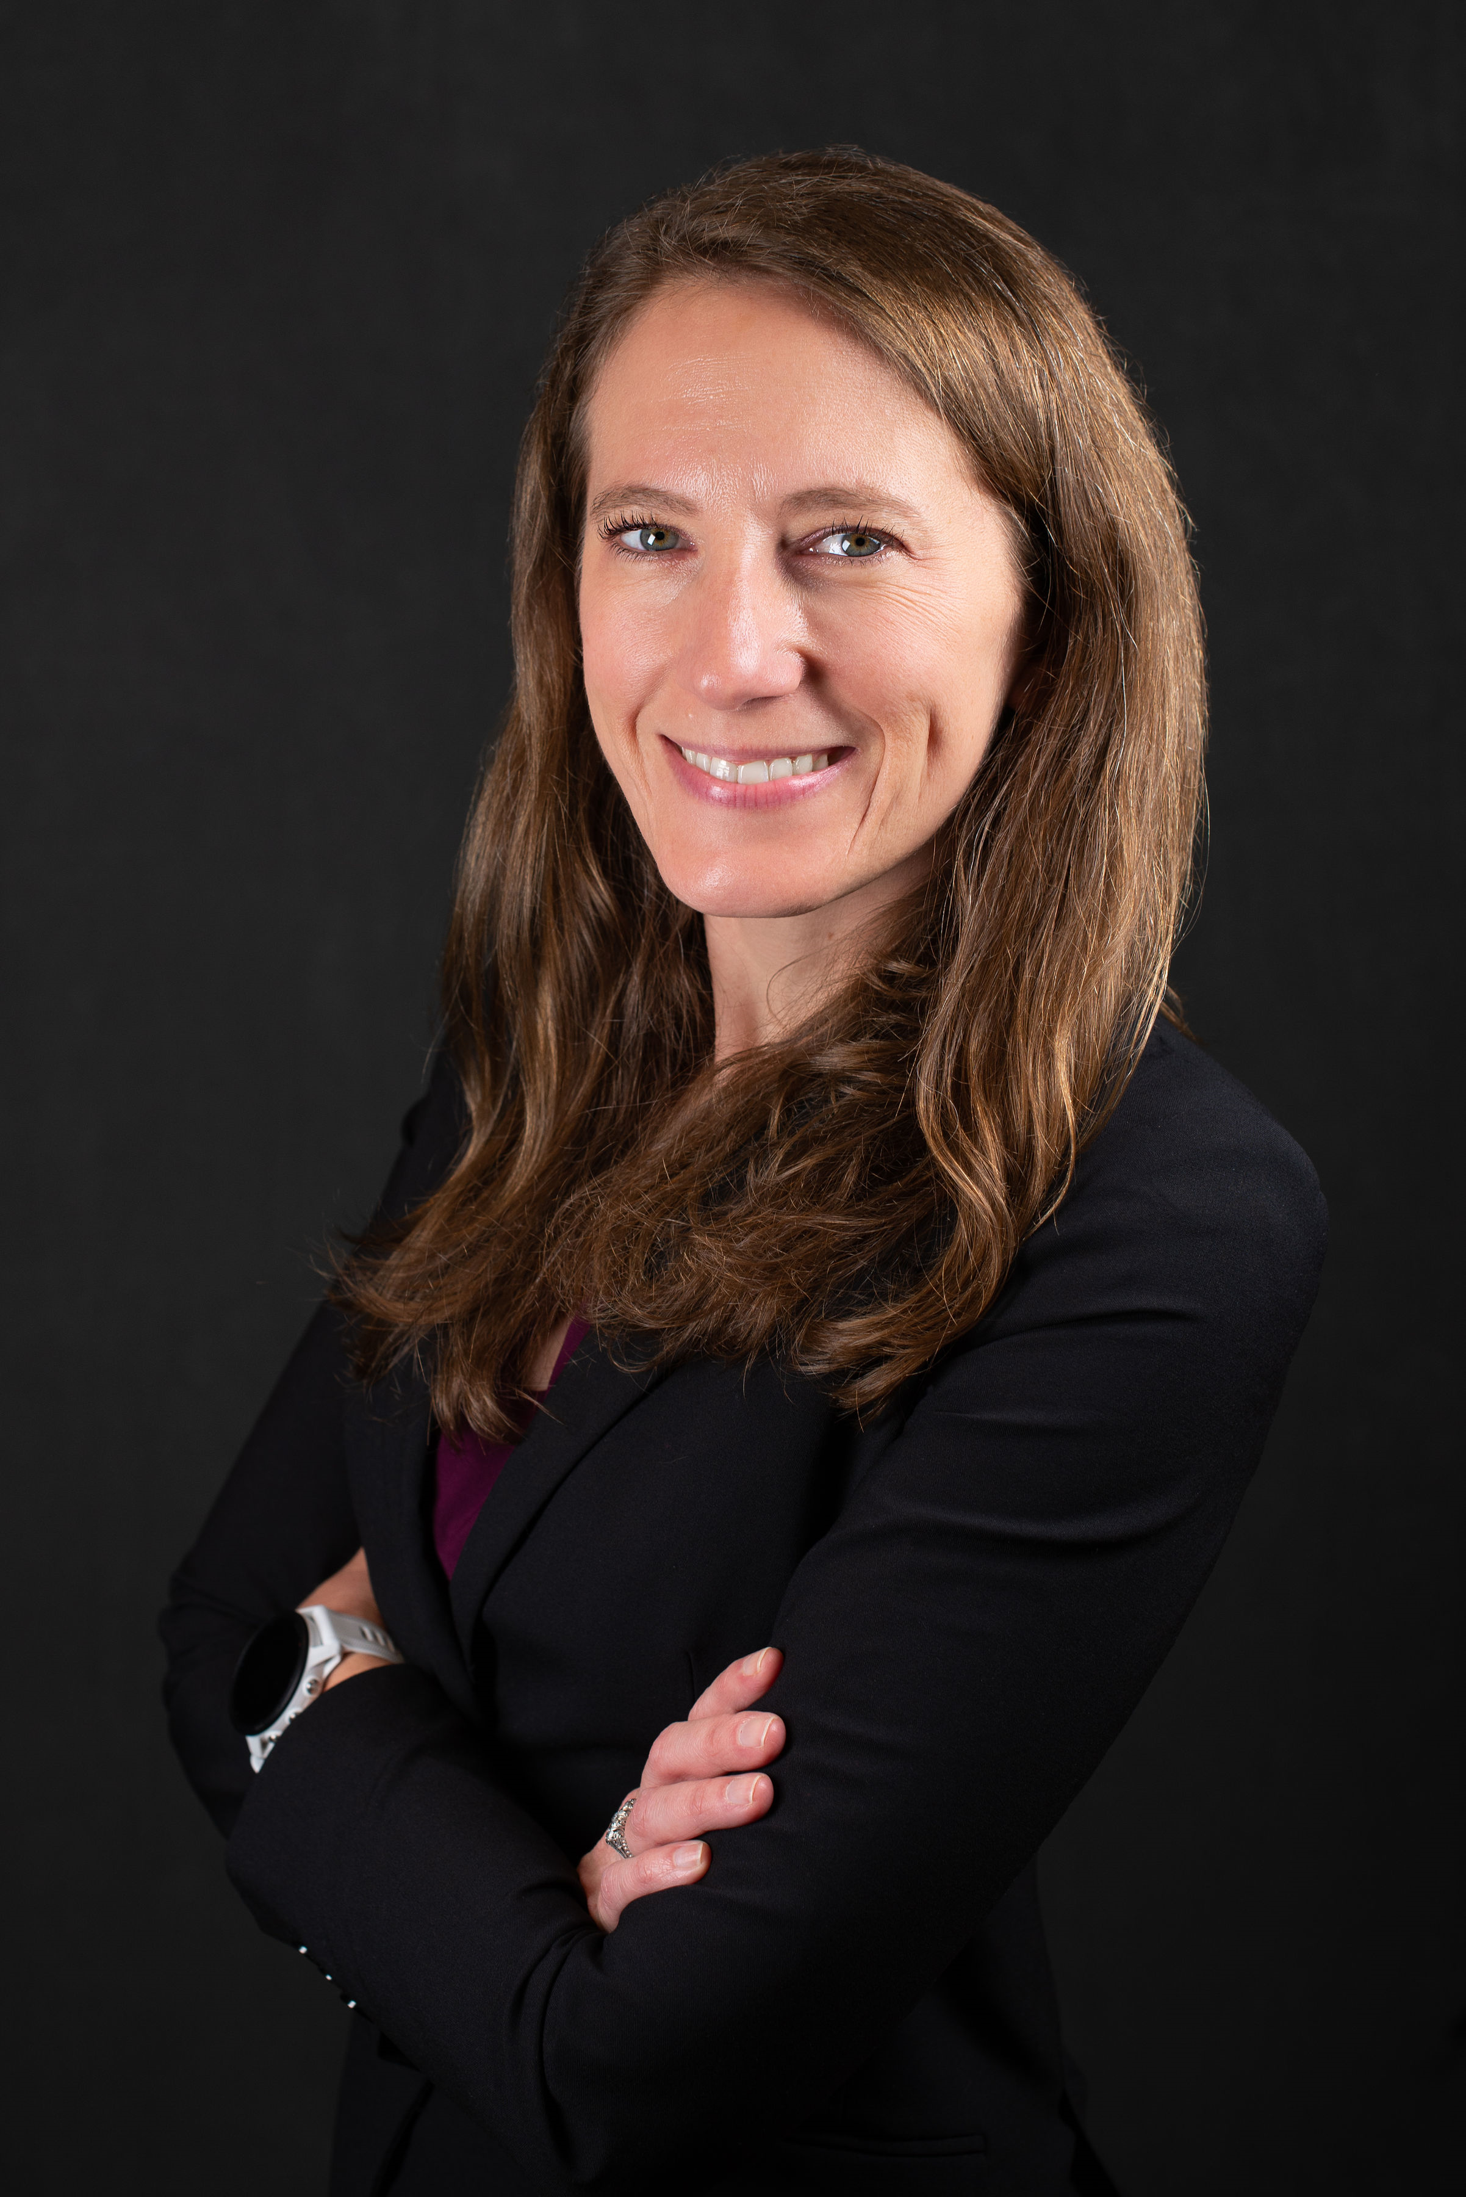
DEPARTMENT OF HISTORY and POLITICAL SCIENCE
History of Egyptology
Research Topics
19th-20th Century British Egyptology
19th-20th Century American Egyptology
Women in the Field
Knowledge Creation in Scientific Networks
Western Tourists in Egypt
Keywords
Egyptology; Women in Science; Scientific Networks; Tourism; Margaret Murray; Mummies; Archaeology; History of Science; James Breasted
Significant achievements
Tea on the Terrace: Hotels and Egyptologists’ Social Networks, 1885-1925. Manchester University Press, 2022
My dear Miss Ransom: Letters between Caroline Ransom Williams and James Henry Breasted, 1898-1935. Oxford: Archaeopress: 2018.
The Life of Margaret Alice Murray: A Woman’s Work in Archaeology. Lexington Books, 2013.
Contact Information
Kathleen Sheppard
Professor, History
Email: sheppardka@mst.edu
Phone: 573-341-4815

